Slide 1
SIC030 - PPT - SESI ke 5 Sistem Perdagangan Elektronik
Ritel Dalam Perdagangan Elektronik (B2C)
M HANIF JUSUF ST MKOM

Slide 2
Learning Objectives
Describe e-tailing and its characteristics.
Define and describe the primary business models of electronic retailing (“e-tailing”).
Describe how online travel and tourism services operate and their industry impact.
Discuss the online employment market, including its participants, benefits, and limitations.

Slide 3
Learning Objectives (cont.)
Describe online real estate transactions.
Discuss online stock trading services.
Discuss cyberbanking and online personal finance.
Describe on-demand delivery by
e-grocers.
Describe the delivery of digital products and online entertainment.

Slide 4
Learning Objectives (cont.)
Discuss various e-tail consumer aids, including comparison-shopping aids.
Identify the critical success factors and failure avoidance tactics for direct online marketing and e-tailing.
Describe reintermediation, channel conflict, and personalization in e-tailing.

Slide 5
Amazon.com: The King of E-Tailing
The opportunity
July 1995, e-tailing pioneer Amazon.com, offered books via an electronic catalog from its Web site (amazon.com)
The company has continually enhanced its business models and electronic store by:
expanding product selection
improving the customer’s experience
adding services and alliances
recognizing the importance of order fulfillment and warehousing

Slide 6
Amazon.com: The King of E-Tailing (cont.)
Technology used
Amazon.com has expanded in a variety of directions:
offers specialty stores (professional and technical store)
expands its editorial content through partnerships with experts in certain fields
increases product selection with the (used and out-of-print titles)
expands its offerings beyond books (June 2002 became an authorized dealer of Sony Corp. selling Sony products online)
today: a diversified retailer of products and services

Slide 7
Amazon.com: The King of E-Tailing (cont.)
Key features of the Amazon.com superstore are:
easy browsing, searching, and ordering
useful product information, reviews, recommendations, and personalization
broad selection
low prices
secure payment systems
efficient order fulfillment
personalization

Slide 8
Amazon.com: The King of E-Tailing (cont.)
Enjoyable features:
“Gift Ideas” section features seasonally appropriate gift ideas and services
“Community” section provides product information and recommendations shared by customers
“E-Cards” section, free animated electronic greeting

Slide 9
Amazon.com: The King of E-Tailing (cont.)
Marketplace services:
hosts and operates auctions
zShops service hosts electronic storefronts for a monthly fee
allowing small businesses the opportunity to have customized storefronts supported by the richness of Amazon.com’s order-fulfillment processing

Slide 10
Amazon.com: The King of E-Tailing (cont.)
Amazon.com is recognized as an online leader in CRM
informative marketing front ends
one-to-one advertisements
free posting of restaurant menus from thousands of restaurants
“Welcome back, Sarah Shopper” with recommendations of new books from the customers preferred genre based on previous purchases

Slide 11
Amazon.com: The King of E-Tailing (cont.)
Sends purchase recommendations via
e-mail to cultivate repeat buyers
Efficient search engine and other shopping aids
Customers can personalize their accounts and manage orders online with the patented “One-Click” order feature including an electronic wallet

Slide 12
Amazon.com: The King of E-Tailing (cont.)
In 1997, Amazon.com started an extensive affiliates program
by 2002, the company had more than 500,000 partners that refer customers to Amazon.com
Amazon pays a 3 to 5% commission on any resulting sale
alliances with major “trusted partners” provide knowledgeable entry into new markets
Carsdirect.com allows it to sell cars online
Drugstore.com connects to health and beauty aids
AT&T, Nextel and others suggest service plans for wireless phones

Slide 13
Amazon.com: The King of E-Tailing (cont.)
September 2001 Amazon signed an agreement with Borders Group Inc
allows Amazon.com’s users to pick up books, CDs, and other merchandise at Borders’ physical bookstores
It is becoming a Web fulfillment contractor for national chains such as:
Target
Circuit City

Slide 14
Amazon.com: The King of E-Tailing (cont.)
The Results
Is the number one e-tailer since 2001 generated $3.12 billion
Is becoming very successful in reducing its costs and increasing its profitability
Annual sales for Amazon.com have trended upward (over $5 billion in 2003)

Slide 15
Amazon.com: The King of E-Tailing (cont.)
$15.7 million in 1996 to $600 million in 1998 to about $4 billion by 2002
In 2003 the site offers over 17 million book, music, and DVD/video titles to some 20 million customers
Offers several features for international customers
In January 2002, Amazon.com declared its first ever profit—for the 2001 fourth quarter

Slide 16
Amazon.com: The King of E-Tailing (cont.)
What can we learn…
demonstrates the evolution of e-tailing
some of the problems encountered by
e-tailers
solutions employed by Amazon.com to expand its business
the opportunities for e-tailing

Slide 17
Internet Marketing and Electronic Retailing (E-Tailing)
Overview of e-tailing
Electronic retailing (e-tailing): Retailing conducted online, over the Internet
E-tailers: Those who conduct retail business over the Internet

Slide 18
Internet Marketing and E-Tailing (cont.)
Size and growth of the B2C market
number of U.S. online buyers from 53.2% of all Internet users in 2001 to 6% by 2020 (90 million people purchasing online)
U. S. revenues from online B2C buying predicted to go from $73 billion in 2001 to $190 billion in 2020
May 2002 sales of $9.8 billion in the first quarter of 2002 (up 19.3 percent from the first quarter of 2001)
annual 2002 sales estimated to be over $40 billion—1.4 % of total retail sales, up from 1.1 percent in 2001
average online shopper spent over $300 per quarter

Slide 19
Internet Marketing and E-Tailing (cont.)
What sells best on the Internet?
Computer hardware and software
Consumer electronics
Sporting goods
Office supplies
Books and music
Toys
Health and beauty
Entertainment
Apparel
Cars
Services
Others

Slide 20
Internet Marketing and E-Tailing (cont.)
Characteristics of successful e-tailing
high brand recognition (Lands’ End)
guarantee provided by highly reliable or well-known vendors (Dell)
digitized format (software)
relatively inexpensive items (office supplies)
frequently purchased items (groceries)
commodities with standard specifications (books), physical inspection unimportant
well-known packaged items that cannot be opened even in a traditional store (vitamins)

Slide 21
E-Tailing Business Models
Classification by distribution channel
Mail-order retailers that go online
Direct marketing from manufacturers
Pure-play e-tailers
Click-and-mortar retailers
Internet (online) malls

Slide 22
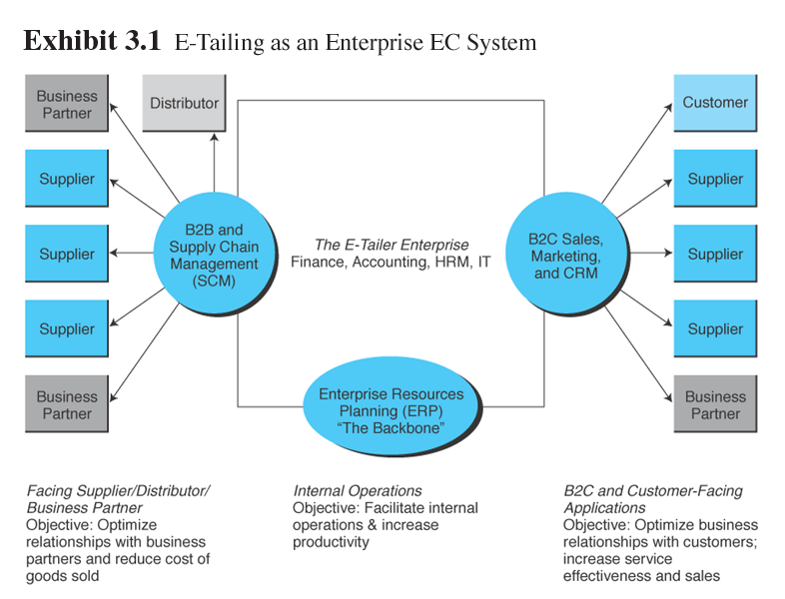
E-Tailing Business Models (cont.)

Slide 23
E-Tailing Business Models (cont.)
Direct marketing by mail order companies
direct marketing: broadly, marketing that takes place without intermediaries between manufacturers and buyers; in the context of this book, marketing done online between any seller and buyer

Slide 24
E-Tailing Business Models (cont.)
Lands’ End: How a mail-order company moved online
Successful because of the logistics system already in place
A subsidiary of Sears, Roebuck and Company
Internet sales in 2000—10% of the company’s $1.3 billion total
Projected Internet sales are 20 percent in 2003

Slide 25
Lands’ End
In 1995 it offered only 100 products online; as of 2002, all of its products are online
Global presence in Japan, Germany, and the United Kingdom
Orders generated online are shipped from these distribution outlets—U.S. customers usually receive their orders 2 days

Slide 26
Lands’ End (cont.)
Women customers can build and store a three-dimensional model of their body (Personal Model) that recommends outfits that flatter certain body profiles and suggests sizes based upon the customer’s measurements
Male customers can use a feature called “Oxford Express” to sort through hundreds of fabrics, styles, collar and cuff options, and sizes within minutes

Slide 27
Lands’ End (cont.)
Personal shopping accounts are available
Customers can track their order status online and request catalogs using the Internet
An affiliate program pays a 5% commission for every sale that comes from a referral
Maintains a B2B “store” at landsend.com/corpsales, where companies can customize clothing such as polo shirts with their logo for use as company uniforms, incentives, or gifts

Slide 28
E-Tailing Business Models
Direct sales by manufacturers
Sellers understand their markets better because of the direct connection to consumers, and consumers gain greater information about the products through direct connection to the manufacturers
Example: Dell Computers—build-to-order approach of customization

Slide 29
E-Tailing Business Models (cont.)
Pure-play e-tailers
Virtual (pure-play) e-tailers: Firms that sell directly to consumers over the Internet without maintaining a physical sales channel
Examples: cattoys.com

Slide 30
E-Tailing Business Models (cont.)
Click-and-mortar retailers: Brick-and-mortar retailers with a transactional Web site from which to conduct business
Brick-and-mortar retailers: Retailers who do business in the non-Internet, physical world in traditional brick-and-mortar stores
Multichannel business model: Describes a company that sells in multiple marketing channels simultaneously (e.g., both physical and online stores)

Slide 31
E-Tailing Business Models (cont.)
Retailing in online malls
Referring directories
directory organized by product type
catalog listings or banner ads at the mall site advertise the products or stores
Malls with shared services
consumer can find the product, order and pay for it, and arrange for shipment
hosting mall provides these services, but they are executed by each store independently

Slide 32
E-Tailing Business Models (cont.)
Other B2C business models
Transaction brokers
Information portals
Community portals
Content creators or disseminators
Viral marketing
Market makers
Build-to-order
Service providers

Slide 33
Travel and Tourism Services Online
Major travel-related Web sites are:
expedia.com
orbitz.com
travelocity.com
asiatravel.com
hotwire.com
travelweb.com
eurovacations.com
priceline.com

Slide 34
Travel and Tourism Services Online (cont.)
Revenue models of online travel services include:
Direct revenues (commissions)
Revenue from advertising
Consultancy fees
Subscription or membership fees
Revenue-sharing fees
Others

Slide 35


Travel and Tourism Services Online (cont.)
Services provided:
Traditional services
providing general information
reserving and purchasing tickets, accommodations, and entertainment

Slide 36
Travel and Tourism Services Online (cont.)
Unique services
travel tips (a visa problem)
electronic travel magazines
fare comparisons
currency conversion calculators
worldwide business and place locators
outlet for travel accessories and books
experts’ opinions
major international and travel news
detailed driving maps and directions
chat rooms and bulletin boards
frequent-flier deals
online travel auctions

Slide 37
Travel and Tourism Services Online (cont.)
Wireless services
check flight status, update frequent flyer miles, and book flights through cell phones
Direct marketing—sell electronic tickets over the Internet
airlines are able to build customer profiles and target specific customers with tailored offers
Alliances and consortia
aggregate participants’ Internet-only fares

Slide 38
Travel and Tourism Services Online (cont.)
Benefits
Huge amount of free information
Accessible at any time from any place
Substantial discounts
Limitations
Amount of time and the difficulty of using virtual travel agencies significant for inexperienced Internet surfers
Complex trips require specialized knowledge

Slide 39

Travel and Tourism Services Online (cont.)
Impact of EC on the travel industry
Consumers who used to order accommodations directly from a hotel are now using the Internet to compare prices and frequently are buying from an intermediary (Hotwire.com)

Slide 40
Travel and Tourism Services Online (cont.)
Corporate travel
To reduce corporate travel costs, companies can make arrangements that enable employees to plan and book their own trips
Using online optimization tools provided by travel companies
Travel authorization software checks availability of funds and compliance with corporate guidelines

Slide 41
Travel and Tourism Services Online (cont.)
Intelligent agents in travel services
Agent is capable of acting autonomously, cooperatively, and collectively to achieve the stated goal
Involved in buyer-seller negotiations
Agents may activate other agents to make special arrangements, cooperate with each other, activate multimedia presentations, or make special inquiries

Slide 42
Employment Placement and the Job Market
The Internet offers a rich environment for job seekers and for companies searching for hard-to-find employees
Who uses the Internet job market?
Job seekers
Employers seeking employees
Job agencies
Government agencies and institutions

Slide 43
Employment Placement and the Job Market (cont.)
Consortium of large employers
directemployers.com
site is used primarily to catalog job postings from the sites of the member employers
Having the job postings of a number of large employers in one place makes it easy for job searchers to explore available openings

Slide 44
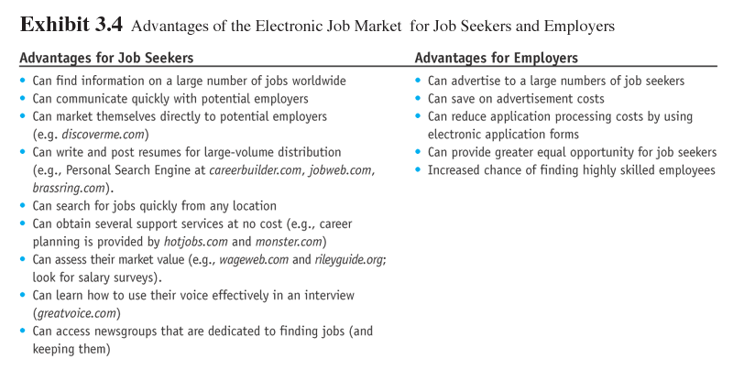
Employment Placement and the Job Market (cont.)

Slide 45
Employment Placement and the Job Market (cont.)
Limitations of the electronic job market:
many people do not use the Internet
security and privacy
create high turnover costs for employers by accelerating employees’ movement to better jobs
finding candidates online is complicated due to the large number of resumes available online

Slide 46
Employment Placement and the Job Market (cont.)
Intelligent agents in the electronic job market—job seekers
free service that uses intelligent agents to search the Internet’s top job sites and databases for job postings based on users’ profiles is offered at careershop.com
users create as many as 5 different profiles based on more than 100 different job categories, geographic regions, and key words.
users receive a daily e-mail containing job opportunities from over a dozen top job sites around the Internet

Slide 47
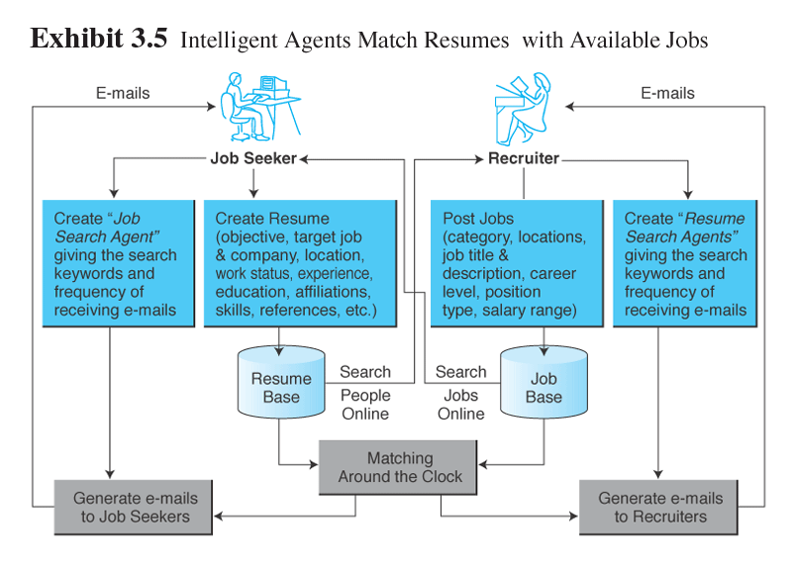
Employment Placement and the Job Market (cont.)

Slide 48
Employment Placement and the Job Market (cont.)
Intelligent agents in the electronic job market—employers (Resumix.com)
hiring managers view job applications
operators can scan resumes
recruiters can search for a candidate or identify existing employees for training programs, redeployment opportunities, or new initiatives

Slide 49
Real Estate Online
Potential homebuyers can:
view many properties online, at any time and from anywhere, saving time for the buyer and the broker
sort and organize properties according to specific criteria and preview the exterior and interior design of the properties, shortening the search process

Slide 50
Real Estate Online (cont.)
Real estate applications
assist2sell.com: advice to consumers on buying or selling a home
realtor.com and land.net: national listing of properties for sale
bankrate.com and eloan.com: information on current mortgage rates
owners.com: persons selling their homes privately without using a real estate agent

Slide 51
Real Estate Online (cont.)
Real estate mortgages
lendingtree.com and eloan.com: online mortgage loans
Priceline.com (priceline.com) offers “name your own price” model for obtaining residential loans
a Singaporean company aggregates loan seekers and then places the package for bid on the Internet

Slide 52
Insurance Online
Standard insurance policies are available online at a substantial discount :
Auto
Home
Life
Health
Third-party aggregators offer free comparisons of available policies

Slide 53
Insurance Online (cont.)
Examples of Internet insurance sites:
insurate.com
order.com
quotesmith.com
insweb.com
insurance.com
ebix.com
quicken.com

Slide 54
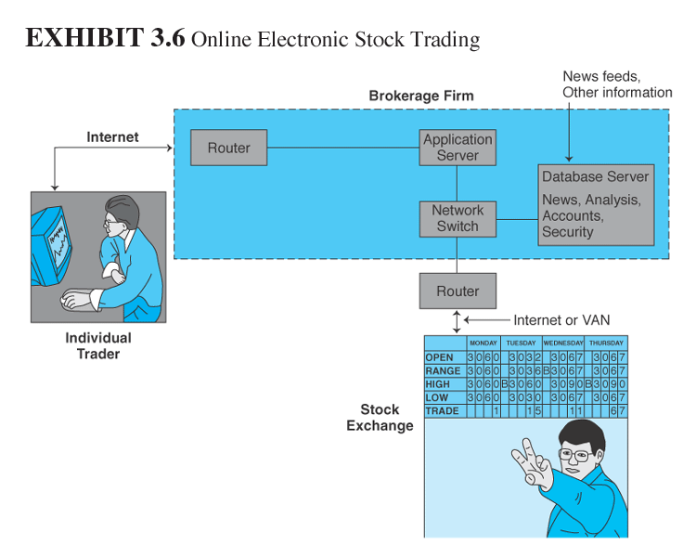
Online Stock Trading

Slide 55
Online Stock Trading (cont.)
Well-known companies that offer online trading:
E*TRADE
Ameritrade
TD
Waterhouse
Suretrade
Discover
Lombard

Slide 56
Online Stock Trading (cont.)
Investment information
money.cnn.com: current financial news
bloomberg.com: municipal bond prices
investorguide.com: overall market information with many links to other financial sites
thestreet.com: free “guru” (expert) advice

Slide 57
Online Stock Trading (cont.)
marketguide.com: stock screening and evaluation tools (MultexInvestor)
ipodata.com: latest on funding and pricing of initial public offerings (IPOs)
bigcharts.com: chart lovers will enjoy
morningstar.com: mutual fund evaluation tools and other interesting investment information

Slide 58
Online Stock Trading (cont.)
firstcall.com: earnings estimates and more
finance.yahoo.com: anything that anyone would need to know about finance and stocks
fool.com: The Motley Fool is a comprehensive site that tries to educate, amuse, and enrich; a portal for individual investors

Slide 59
Online Stock Trading (cont.)
Related financial markets
Commodities
Financial derivatives
Mortgage banking
Risk of having online stock accounts
All trading sites require users to have an ID and password

Slide 60
Banking and Personal Finance Online
electronic banking (e-banking): Various banking activities conducted from home or the road using an Internet connection; also known as cyberbanking, virtual banking, online banking, and home banking

Slide 61
Banking and Personal Finance Online (cont.)
Dangers of online trading
almost 55% of stock trading in Korea is done online
fraudulent online stock trading—August 2002
A criminal used a PC in an Internet cafe to place a buy order at a fairly high price for 5 millions shares of Delta Information and Communication in the name of a well-known buyer

Slide 62
Banking and Personal Finance Online (cont.)
Using the trust company’s stolen account number and password
In 90 seconds, over 100 people sold more than 10,000 shares each for a total of 2.7 million shares pushing the price of the shares way up
Hacker stopped buying and disappeared
Without buyers the price of Delta’s shares started to decline
In 2 days Daewoo Securities (manager of the Hyundai account) suffered U.S. $5 million paper losses

Slide 63
Banking and Personal Finance Online (cont.)
Home banking capabilities
View current account balances and history at anytime
Obtain charge and credit card statements
Pay bills
Download account transactions
Transfer money between accounts
Balance accounts
Send e-mail to the bank
Expand the meaning of “banker’s hours”
Handle finances when traveling
Use additional services

Slide 64
Banking and Personal Finance Online (cont.)
Virtual banks
Have no physical location, but only conduct online transactions
NetBank (netbank.com)
First Internet Bank (firstib.com)
Make sure that the bank is legitimate before sending money to a virtual bank

Slide 65
Banking and Personal Finance Online (cont.)
International and multiple-currency banking
Hong Kong Bank developed a special system called HEXAGON to provide electronic banking in Asia
Tradecard and MasterCard have developed a multiple-currency system for global transactions

Slide 66
Banking and Personal Finance Online (cont.)
Bank of America and most other major banks offer:
international capital raising
cash management
trades and services
foreign exchange
risk management investments
merchant services
special services for international traders

Slide 67
Banking and Personal Finance Online (cont.)
Fxall.com is a multidealer foreign exchange service that enables faster and cheaper foreign exchange transactions
Special services are being established for stock market traders who need to pay for foreign stocks

Slide 68
Banking and Personal Finance Online (cont.)
Implementation issues in online financial transactions:
securing financial transactions
access to banks’ intranets by outsiders
using imaging systems
pricing online versus off-line services
risks

Slide 69
Online Security Bank of America
Online security at Bank of America—security safeguards provided:
encryption provided by SSL (Secure Socket Layer)
maintains accurate information; corrections made quickly
information is shared among the company’s family of partners only for legitimate business purposes

Slide 70
Online Security Bank of America (cont.)
Does not capture information provided by customers
Customers can control both the collection and use of information collected by cookies
Provides suggestions on how users can increase security

Slide 71
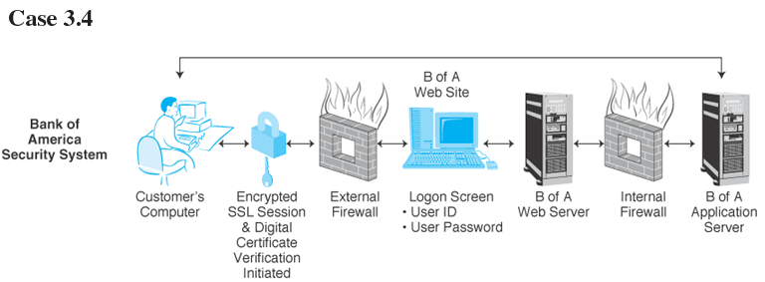
Online Security Bank of America (cont.)

Slide 72
Banking and Personal Finance Online (cont.)
Personal finance online
Combine electronic banking with personal finance and portfolio management
Personal finance services such as retirement planning

Slide 73
Banking and Personal Finance Online (cont.)
Specialized personal finance software
bill paying and electronic check writing
tracking of bank accounts, expenditures, and credit cards
portfolio
investment tracking and monitoring of securities
stock quotes and past and current prices of stocks
personal budget organization
record keeping of cash flow and profit and loss computations
tax computations and preparations
retirement goals, planning, and budgeting

Slide 74
Banking and Personal Finance Online (cont.)
Online billing and bill paying
Automatic transfer of mortgage payments
Automatic transfer of funds to pay monthly utility bills
Paying bills from online banking accounts
Merchant-to-customer direct billing
Using an intermediary for bill consolidation
Person-to-person direct payment

Slide 75
Banking and Personal Finance Online (cont.)
Taxes
irs.gov: extensive tax-related site run by the U.S. government
webtax.com: massive directory of tax-related information, research, and services
fairmark.com: a tax guide for investors
moneycentral.msn.com/tax/workshop: useful reference and educational site
quicken.com/taxes: emphasizes tax planning

Slide 76
Banking and Personal Finance Online (cont.)
taxcut.com/taxtips and smartmoney.com/ac/tax: advice on ways to minimize taxes
taxprophet.com: tax advice in an entertaining manner
bankrate.com/brm/itax: informative articles about taxation
1040.com: teaches about deduction rules
unclefed.com: advice on audits

Slide 77
On-Demand Delivery Services and E-Grocers
E-grocer: A grocer that will take orders online and provide deliveries on a daily or other regular schedule or will deliver items within a very short period of time
On-demand delivery service: Express delivery made fairly quickly after an online order is received

Slide 78
On-Demand Delivery Services and E-Grocers (cont.)
E-grocers
offer consumers the ability to order items online and have them delivered to their houses free
regular “unattended” weekly delivery based on a monthly subscription model
on-demand deliveries—a surcharge and additional delivery charge
nonperishable items shipped via common carrier
dry-cleaning pickup and delivery
“don’t run out” automatic reordering
fresh flower delivery
movie rentals
meal planning
recipe tips
multimedia features
nutritional information

Slide 79

On-Demand Delivery Services and E-Grocers (cont.)
Who are e-grocery shoppers?
Shopping avoiders
Necessity users
New technologists
Time-starved consumers

Slide 80
Example: Safeway
Grocery shopping in the palm of your hand
Safeway implemented its Easi-Order services using a Palm handheld device (PDA) to allow customers to point and click their grocery lists and send them to Safeway via phone
Part of the company’s “Collect & Go” service

Slide 81
Safeway (cont.)
Valued customers are given handheld devices that are loaded with an application that contains a list of thousands of grocery items, including descriptions and prices
Customers review the items and make their grocery lists off-line when time permits
Estimated time savings is 60 to 90 minutes each week

Slide 82
Safeway (cont.)
Device is plugged into a standard phone socket, and it dials up the Collect & Go server
Shopping list is downloaded to the server, and next week’s suggested list along with suggestions and promotions are uploaded to the device
Data collected by Safeway allow the company to offer outstanding customer service

Slide 83
Safeway (cont.)
Order is picked and packed by the store and set aside for the customer to pick up at their specified, convenient time
Collection at dedicated checkout counters—Easi-Pay terminals, which allow customers to avoid check-out lines altogether
Home delivery may also be available

Slide 84
Safeway (cont.)
Customers download their orders directly to the Collect & Go intranet through the Internet
In the future, Safeway plans to have screen phones, digital TV, and speech processing devices assist grocery shoppers in making their shopping experiences as easy as verbally telling the program what they want

Slide 85
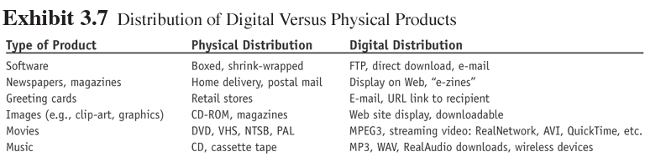
Online Delivery of Digital Products, Entertainment, and Media
Digital products: products that can be transformed to digital format and delivered over the Internet

Slide 86
Online Delivery of Digital Products, Entertainment, and Media (cont.)
Napster
Consumers-to-consumers (peer-to-peer) digital distribution
Napster only shares “libraries” or lists of songs, and then enables a peer-to-peer file-sharing environment
Sued for copyright infringement in 2002

Slide 87
Online Delivery of Digital Products, Entertainment, and Media (cont.)
Free file sharing is no longer allowed
Napster forced to charge customers for use of its file-sharing service
Entered into an agreement with Bertelsmann AG (large global music label that participated in the lawsuit against Napster)
Went into bankruptcy in 2002
Roxio purchaced and reopened in late 2003 as “for fee file-sharing service”

Slide 88
Online Delivery of Digital Products, Entertainment, and Media (cont.)
Online entertainment
Interactive entertainment
Web browsing
Internet gaming
Single and multiplayer games
Adult entertainment
Participatory Web sites
Reading

Slide 89
Online Delivery of Digital Products, Entertainment, and Media (cont.)
Noninteractive entertainment
Event ticketing
Restaurants
Information retrieval
Retrieval of audio and video entertainment

Slide 90
Online Delivery of Digital Products, Entertainment, and Media (cont.)
Developments in the delivery of digital products
Custom CD sites (angelfire.com and grabware.com)
Disintermediation of traditional print media (pcai.com and wsj.com)

Slide 91
Online Purchase Decision Aids
Shopping portals: Gateways to storefronts and malls; may be comprehensive or niche oriented
dealtime.com
shopping.yahoo.com
eshop.msn.com
webcenter.shop.aol.com

Slide 92
Online Purchase Decision Aids (cont.)
shopping robots (shopping agents or shopbots): Tools that scout the Web on behalf of consumers who specify search criteria
autobytel.com
Zdnet.com/computershopper
office.com
dealtime.com

Slide 93
Online Purchase Decision Aids (cont.)
“Spy services”
services that visit Web sites for you, at your direction, and notify you of their findings
spyonit.com
web2mail.com
alerts.yahoo.com
Wireless shopping comparisons
Mysimon.com
AT&T Digital PocketNet

Slide 94
Online Purchase Decision Aids (cont.)
Business rating sites
Bizrate.com
Consumer Reports Online (consumerreports.org)
Forrester Research (forrester.com)
Gomez Advisors (gomez.com)

Slide 95
Online Purchase Decision Aids (cont.)
Trust verifications sites:
evaluate and verify the trustworthiness of various e-tailers
TrustE
Versign
BBB online
Webtrust
Trust

Slide 96
Online Purchase Decision Aids (cont.)
Other shopping tools
digital intermediaries assist buyers or sellers, with the research and purchase processes
communities of consumers who offer advice and opinions on products and
e-tailers (epinions.com)
wallet—is a program that contains the shopper’s information

Slide 97
Successful Click-and-Mortar Strategies
Speak with one voice
Empower the customer
Leverage the multichannels

Slide 98
Example: Circuit City
Transformation to click-and-mortar: Circuit City
1999, Circuit City’s Web site largely a brochureware site capable only of selling gift certificates
EC system credit card authorization and inventory-management systems were in place

Slide 99
Circuit City (cont.)
Features of the circuitcity.com site:
educates customers about the various features and capabilities of different products
customers gain valuable knowledge to assist them in the purchase decision
extensive amount of information about electronics and other products, organized in a very flexible way

Slide 100
Circuit City (cont.)
Online purchase to be smooth, secure, and seamless
Order fulfillment method is flexible
receive the purchase via common carrier
pay a larger shipping charge for overnight delivery
pick up the item at the nearby brick-and-mortar store

Slide 101
Successful Click-and-Mortar Strategies (cont.)
Alliance of virtual and traditional retailers: Amazon.com and ToysRUs
Amazon.com known as a premier site for creating customer loyalty and for driving sales through its execution of CRM with efficient back-office order fulfillment systems
ToysRUs known for its broad product offerings and a deep understanding of the toys market, customer tastes, and suppliers

Slide 102
Successful Click-and-Mortar Strategies (cont.)
During the 1999 Christmas season, before their alliance, both companies failed to profitably deliver toys on time
They have pooled their expertise to form a single online toy store
The alliance allows the partners to leverage each other’s core strengths
The two companies must coordinate disparate systems—operational, technological, and financial—as they merge their corporate cultures

Slide 103
Problems with E-Tailing and Lessons Learned
Reasons retailers give for not going online include:
product is not appropriate for Web sales
lack of significant opportunity
too expensive
technology not ready
online sales conflict with core business

Slide 104
Problems with E-Tailing and Lessons Learned (cont.)
Failures in B2C dot-coms
Kozmo.com—a creative idea for on-demand deliveries of movie rentals—difficulty in how to return the videos
Furniture.com—difficulty in delivering products in a timely manner
eRegister.com—registering for courses etc. online was not popular with consumers

Slide 105
Problems with E-Tailing and Lessons Learned (cont.)
Go.com—business model called for selling a large amount of ad impressions, which proved to be impossible
Pets.com—cost of acquiring customers was too costly

Slide 106
Problems with E-Tailing and Lessons Learned (cont.)
Lessons learned:
Don’t ignore profitability
Manage new risk exposure
Watch the cost of branding
Do not start with insufficient funds
The web site must be effective
Keep it interesting

Slide 107
Issues in E-Tailing
Disintermediation: The removal of organizations or business process layers responsible for certain intermediary steps in a given supply chain
Reintermediation: The process whereby intermediaries (either new ones or those that had been disintermediated) take on new intermediary roles

Slide 108
Issues in E-Tailing (cont.)
Cybermediation (electronic intermediation): The use of software (intelligent) agents to facilitate intermediation
Hypermediation: Extensive use of both human and electronic intermediation to provide assistance in all phases of an e-commerce venture

Slide 109
Issues in E-Tailing (cont.)
Unbundling: old economy processes will be broken into specialized segments that can be delivered by specialized intermediaries
Channel conflict: Situation in which an online marketing channel upsets the traditional channels due to real or perceived damage from competition

Slide 110
Issues in E-Tailing (cont.)
Determining the right price
prices competitive on the Internet
prices should be in line with the corporate policy on profitability
Personalization
use cookie files and other technologies to track the specific browsing and buying behavior of each consumer
marketing plan tailored to that consumer’s pattern

Slide 111
Managerial Issues
Should we grab a first-mover advantage or wait and learn?
What should our strategic position be?
Are we financially viable?
Should we recruit out of town?

Slide 112
Managerial Issues (cont.)
Are there international legal issues regarding online recruiting?
Do we have ethics and privacy guidelines?
How will intermediaries act in cyberspace?
Should we set up alliances?

Slide 113
Summary
The scope of e-tailing
E-tailing business models
How online travel/tourism services operate
The online job market and its benefits
The electronic real estate market
Online trading of stocks and bonds

Slide 114
Summary (cont.)
Cyberbanking and personal finance
On-demand delivery service
Delivery of digital products
Aiding consumer purchase decisions
Critical success factors
Disintermediation and reintermediation

Slide 115

Selesai

